Slide 1
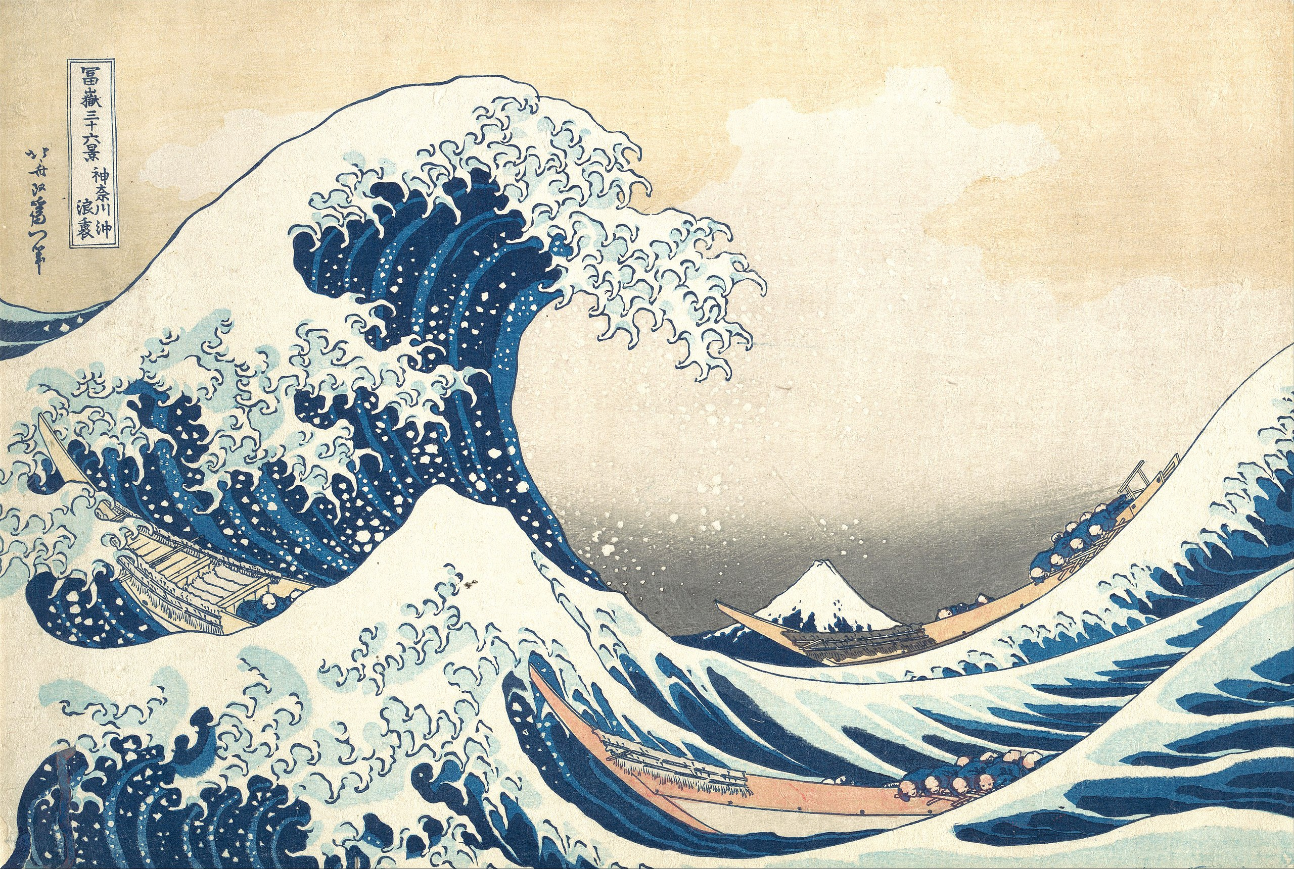
How do atmospheric sources of energy mix the ocean?
The great wave of Kanagawa Katsushika Hokusai 1831

Slide 2
By the end of this lesson I hope that you can:
Describe main sources of energy that drive ocean surface boundary layer mixing
Evaluate the relative impact of winds and buoyancy flux on the ocean surface boundary layer
Use Monin-Obhukov scaling to quantify wind stress forcing vs buoyancy forcing [next lecture]
Compare and contrast the response of the ocean to atmospheric forcing under different initial ocean conditions [next lecture]
Recommended reading:
Cronin and Sprintall, 2001. Wind and buoyancy forced upper ocean doi:10.1006/rwos.2001.0157
Moum and Smyth, 2001. Upper ocean mixing processes doi:10.1006/rwos.2001.0156

Slide 3
Before we start:
Follow the link and open the binder
https://github.com/isgiddy/pil102_example
https://mybinder.org/v2/gh/isgiddy/pil102_example/HEAD

Slide 4
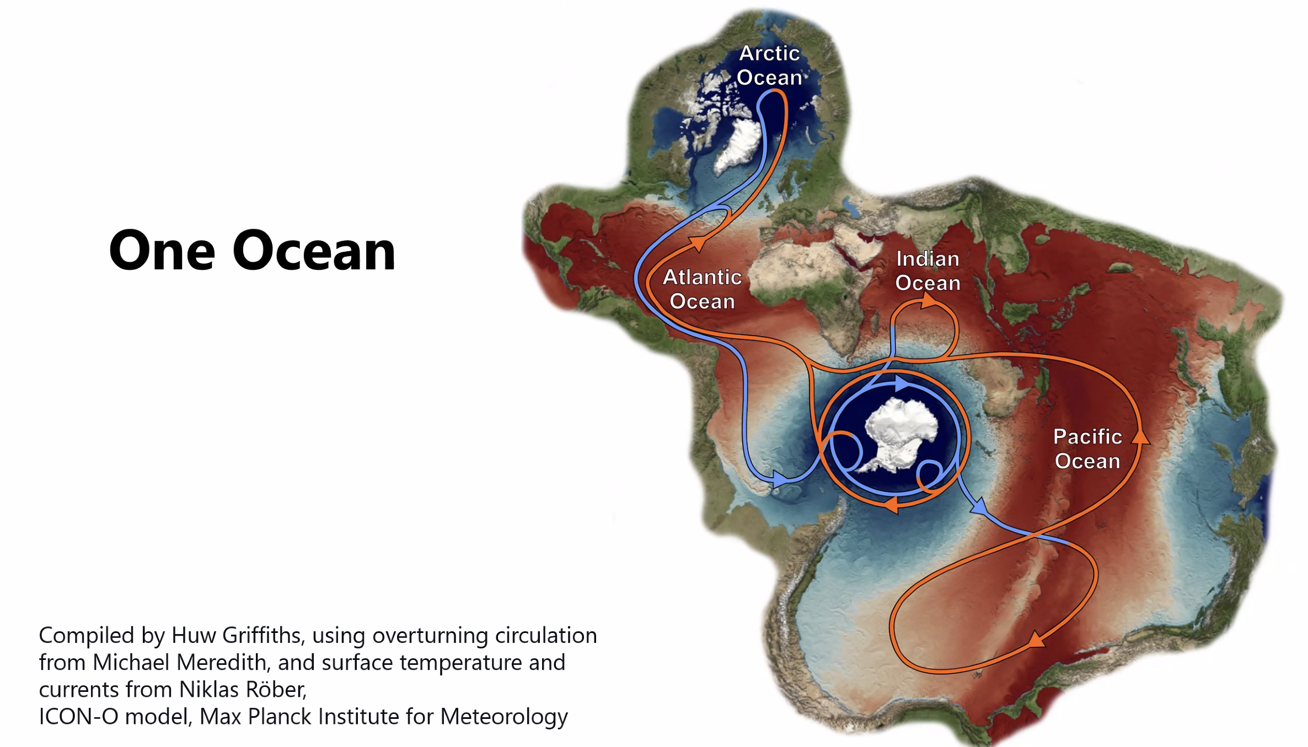
Some motivation
The exchange of water properties at the ocean surface boundary layer regulates our earths climate

Slide 5
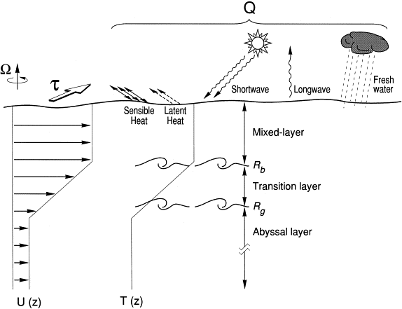
Some Key definitions
The ocean surface boundary layer: the uppermost layer of the ocean that is in contact with the atmosphere. It is the site of active air-sea exchange
Price et al., 1986
Notes:
The great wave off kanagawa Katsushika Hokusai 1831

Slide 6
Some Key definitions
The ocean surface boundary layer: the uppermost layer of the ocean that is in contact with the atmosphere
Density stratification: vertical distribution of waters with distinct density classes in horizontal layers increasing in density with depth (stable).
A function of temperature and salinity of the water
Price et al., 1986
Notes:
The great wave off kanagawa Katsushika Hokusai 1831

Slide 7
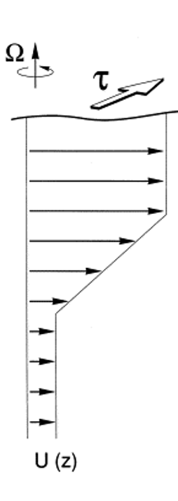
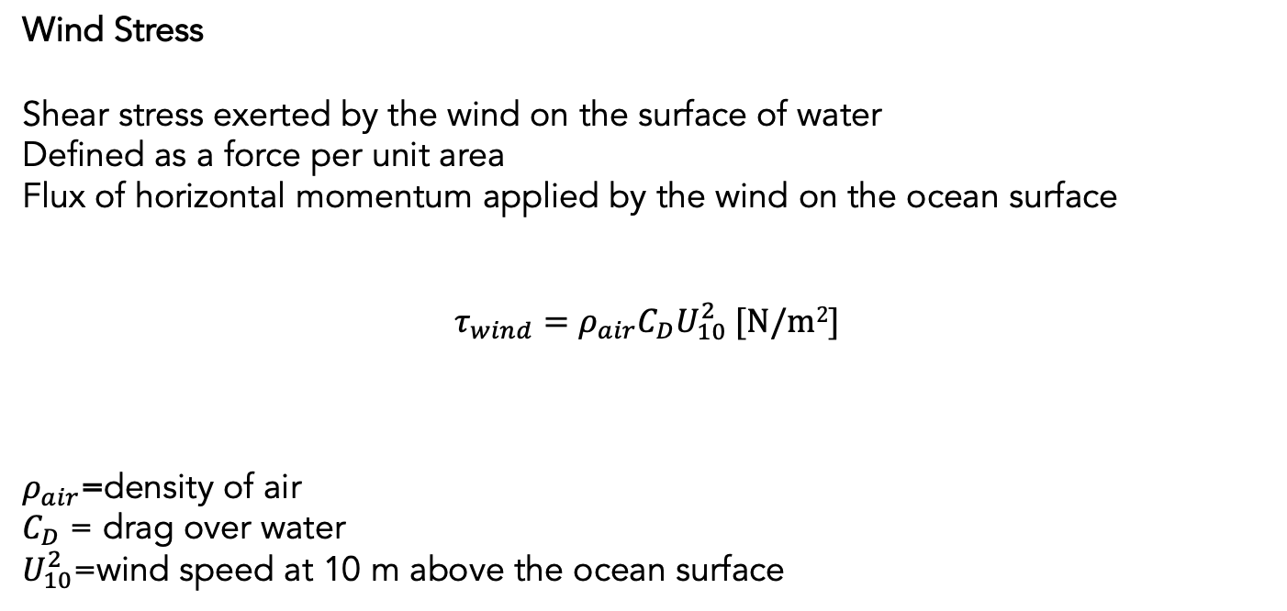
Some Key definitions
Wind Stress
Shear stress exerted by the wind on the surface of water
Defined as a force per unit area
Flux of horizontal momentum applied by the wind on the ocean surface
$$τ_{wind}=ρ_{air}C_{D}U_{10}^{2} [N/m2]$$
$ρ_{air}$=density of air
$C_{D}$ = drag over water
$U_{10}^{2}$=wind speed at 10 m above the ocean surface
Notes:
The great wave off kanagawa Katsushika Hokusai 1831

Slide 8
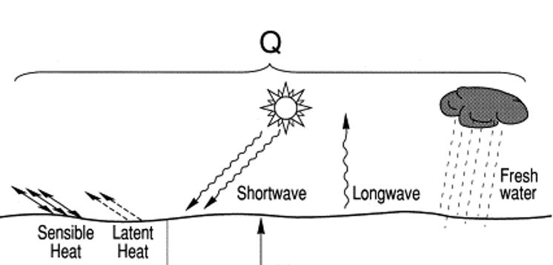
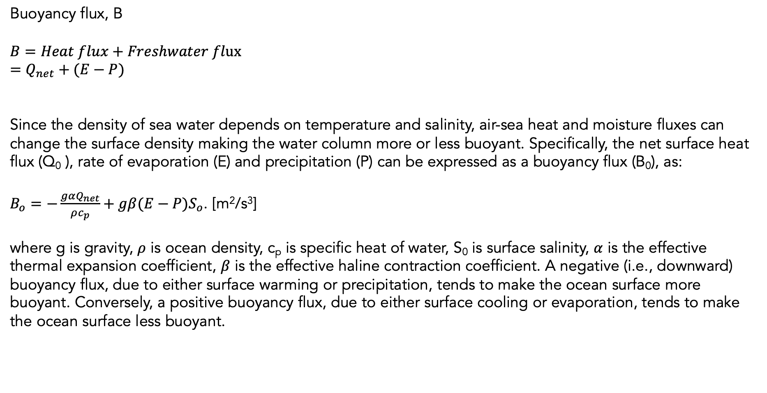
Some Key definitions
Buoyancy flux, B $$B=Heat flux+Freshwater flux \\ =Q_{net}+(E−P)$$
Since the density of sea water depends on temperature and salinity, air-sea heat and moisture fluxes can change the surface density making the water column more or less buoyant. Specifically, the net surface heat flux (Q₀ ), rate of evaporation (E) and precipitation (P) can be expressed as a buoyancy flux (B₀), as:
$B_{o}=−\frac{gαQ_{net}}{ρc_{p}}+gβ(E−P)S_{o}$. [m²/s³]
where g is gravity, $ρ$ is ocean density, c_{p} is specific heat of water, S₀ is surface salinity, $α$ is the effective thermal expansion coefficient, $β$ is the effective haline contraction coefficient. A negative (i.e., downward) buoyancy flux, due to either surface warming or precipitation, tends to make the ocean surface more buoyant. Conversely, a positive buoyancy flux, due to either surface cooling or evaporation, tends to make the ocean surface less buoyant.
Notes:
The great wave off kanagawa Katsushika Hokusai 1831

Slide 9
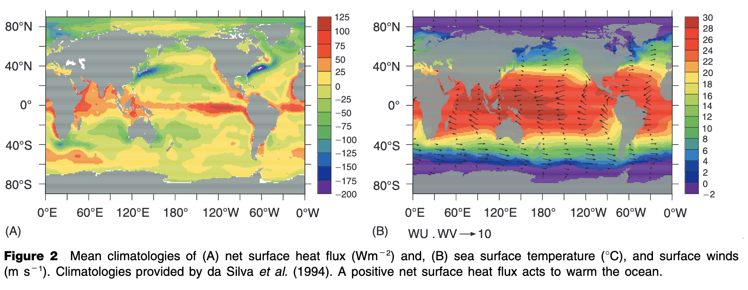
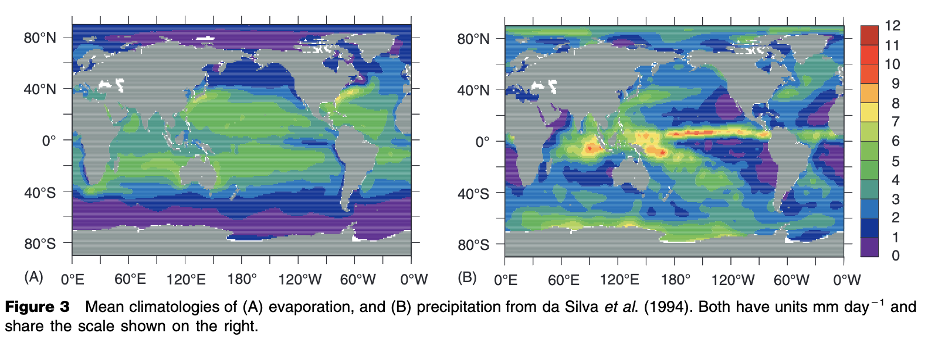
Cronin and Sprintal, 2001

Slide 10
Interruption!
Follow the link and open the binder
https://github.com/isgiddy/pil102_example
https://mybinder.org/v2/gh/isgiddy/pil102_example/HEAD
In break out rooms, run through the code and discuss the results (5 minutes)
Do this together and share screen or individually
2 groups:
Case2: Stabilizing conditions
Case3: Convective conditions

Slide 11
Interruption!
**If this doesn’t work, give results to each breakout room
Discuss the results (5 minutes).
2 groups:
Case2: Stabilizing conditions
Case3: Convective conditions

Slide 12
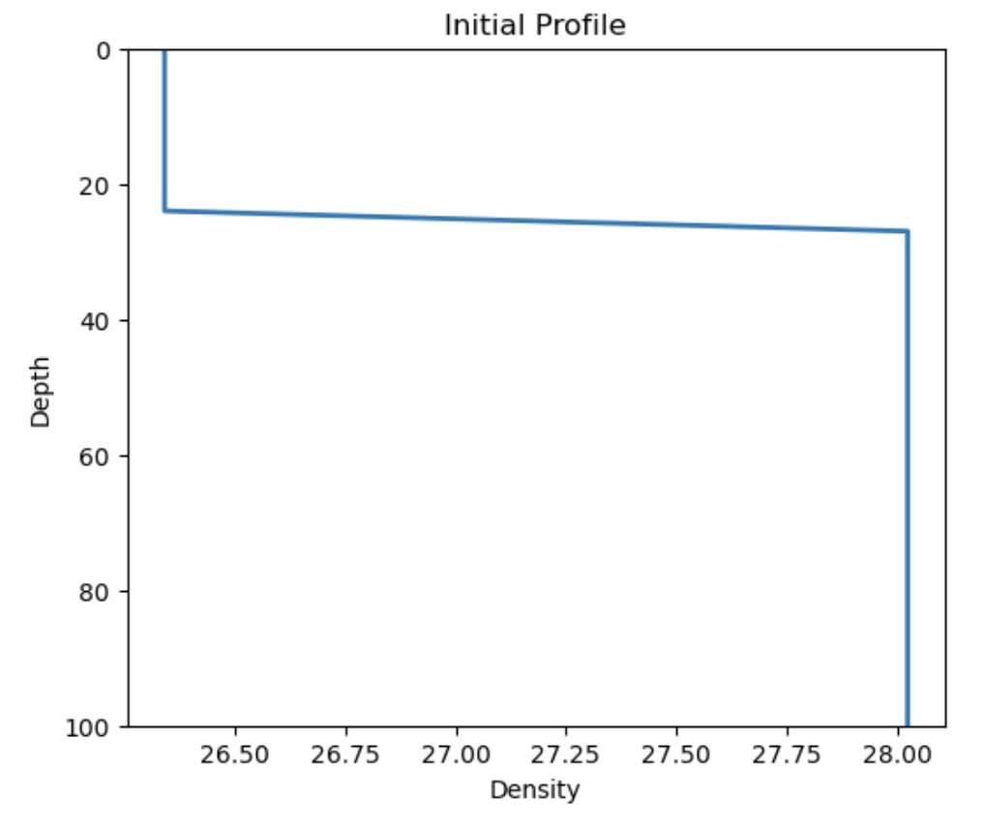
Apply some force:
B_{o} = 0
U₁₀

Slide 13
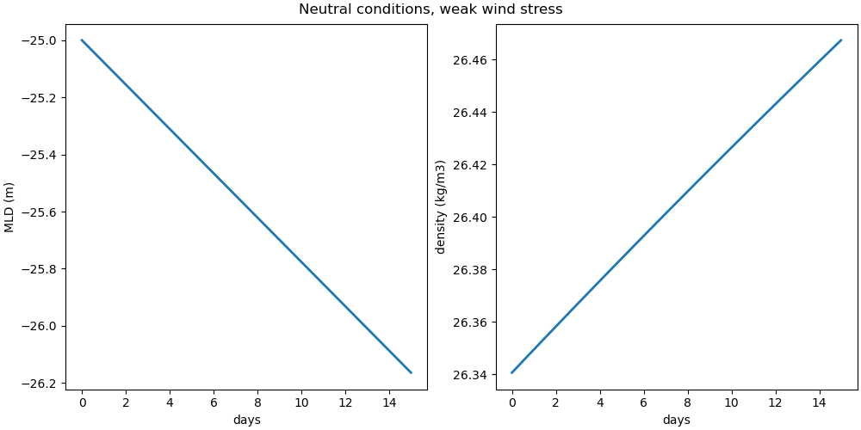
Apply some force:
B_{o} = 0
U₁₀
Mixed layer will deepen, and get slightly more dense – mixing up more dense water from below

Slide 14
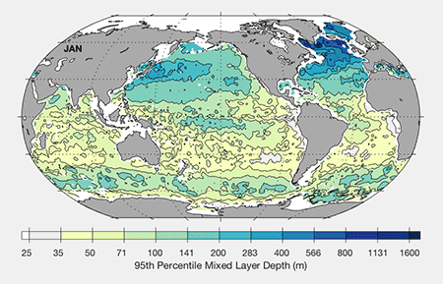

Slide 15
Cronin and Sprintal, 2001

Slide 16
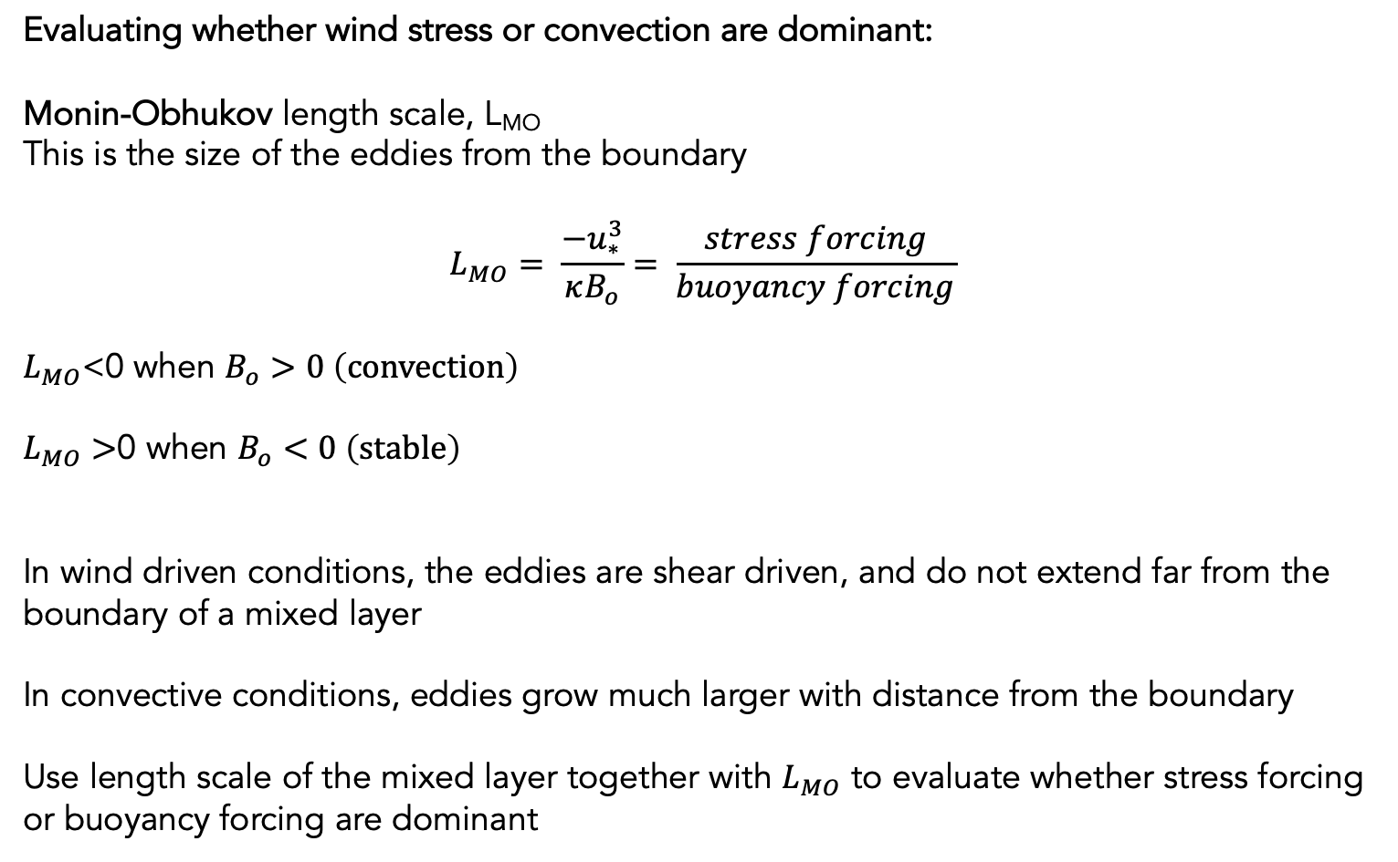
Evaluating whether wind stress or convection are dominant:
Monin-Obhukov length scale, L_{MO}
This is the size of the eddies from the boundary
$$L_{MO}= \frac{−u_{∗}^{3}}{κB_{o}}= \frac{stress forcing}{buoyancy forcing}$$
$L_{MO}$<0 when $B_{o}>0 \left(convection\right)$
$L_{MO}>$0 when $B_{o}<0 \left(stable\right)$
In wind driven conditions, the eddies are shear driven, and do not extend far from the boundary of a mixed layer
In convective conditions, eddies grow much larger with distance from the boundary
Use length scale of the mixed layer together with $L_{MO}$ to evaluate whether stress forcing or buoyancy forcing are dominant

Slide 17
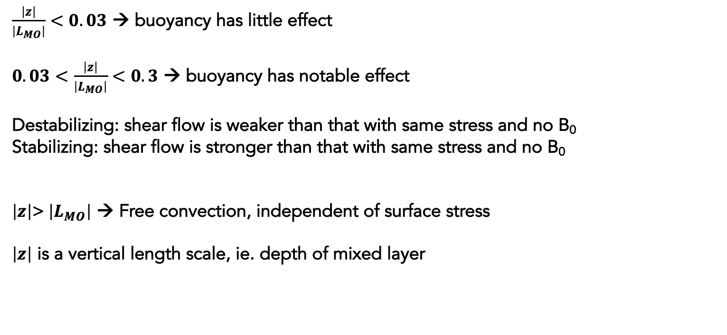
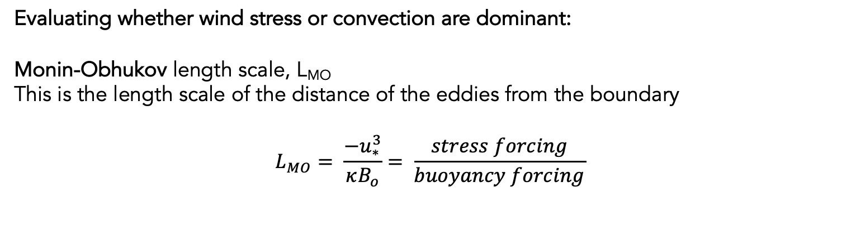
Evaluating whether wind stress or convection are dominant:
Monin-Obhukov length scale, L_{MO}
This is the length scale of the distance of the eddies from the boundary
$$L_{MO}= \frac{−u_{∗}^{3}}{κB_{o}}= \frac{stress forcing}{buoyancy forcing}$$
$\frac{\left|z\right|}{\left|L_{MO}\right|}<0.03$ → buoyancy has little effect
$0.03<\frac{\left|z\right|}{\left|L_{MO}\right|}<0.3$ → buoyancy has notable effect
Destabilizing: shear flow is weaker than that with same stress and no B₀
Stabilizing: shear flow is stronger than that with same stress and no B₀
$\left|z\right|$> $\left|L_{MO}\right|$ → Free convection, independent of surface stress
$\left|z\right|$ is a vertical length scale, ie. depth of mixed layer

Slide 18
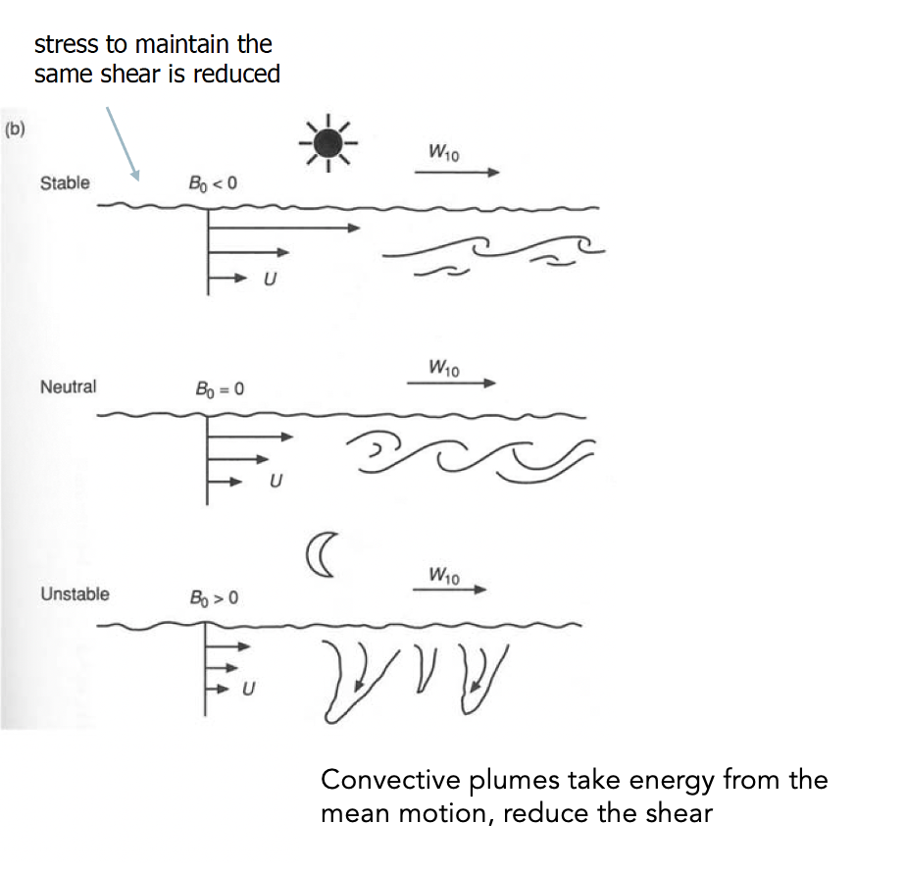
Summary

Slide 19

Mentimeter reflection

